Slide 1
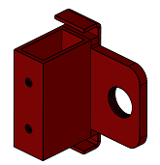
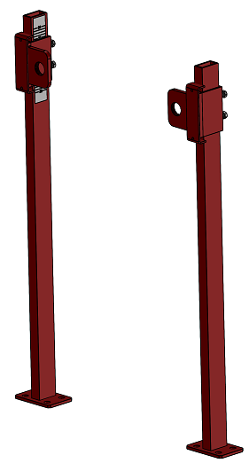
MC-41 – INSTALLATION GUIDE
Header brackets
Slide header brackets
over uprights, adjust
their height using
side ruler and secure
with provided bolts
Secure carrier
uprights to floor
into pipe case
Uprights

Slide 2
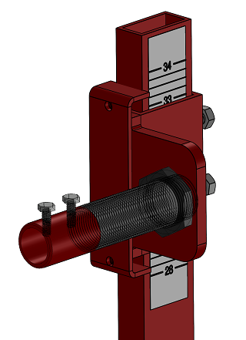
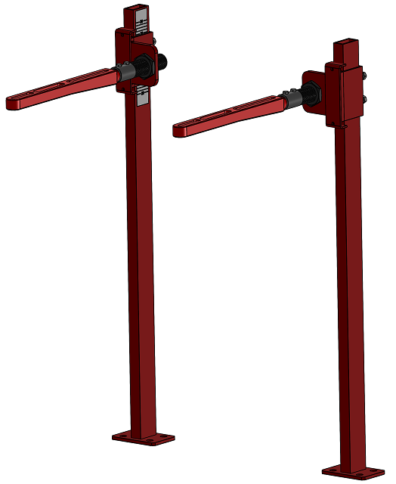
Leveling Bolts
Set-up 1” nipple
to support ductile
iron arms
Mount the
concealed ductile
iron arms to
support lavatory
and adjust the
leveling bolts
Concealed Arms
Nipple (1”) support

Slide 3
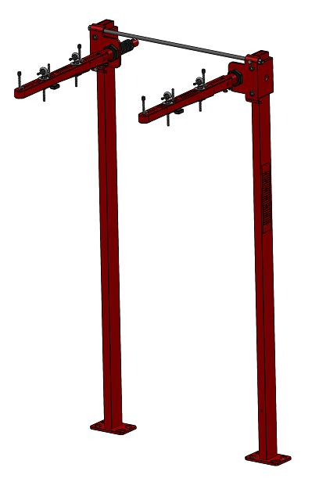
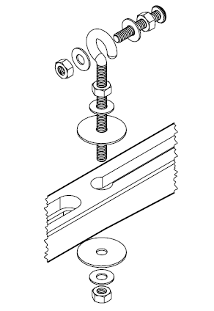
Install the eye-bolts
as shown below:

